Slide 1
2022 Progress Report on New Jersey’s Resource Adequacy Alternatives
Update regarding Staff’s Investigation of Resource Adequacy Alternatives, Docket #EO20030203
Board of Public Utilities Staff
September 2022

Slide 2
Welcome
This stakeholder meeting is to discuss Staff’s update to the Board’s Investigation of Resource Adequacy Alternatives, under:
Docket #EO20030203
This meeting will focus on Staff’s “2022 Progress Report on New Jersey’s Resource Adequacy Alternatives,” issued on September 22, 2022.

Slide 3
Webinar Instruction Page
All attendees will be automatically muted until called upon to speak.
When we get to the public comment portion, we will start with speakers who pre-registered. You will be called up and then unmuted.
Speakers who did not pre-register may raise their hand to speak and will be called on.
We are going to ask speakers to keep their comments to less than 8 minutes.
Questions? Please use the “Q & A” function in Zoom.
Please note that the “Chat” function in Zoom is not available for this meeting.
This meeting is being recorded.
A copy of the recording and slides will be made available on the BPU website: https://www.nj.gov/bpu/newsroom/public/

Slide 4
Disclaimer
This presentation is provided for informational purposes only and should not be taken to represent the views of the New Jersey Board of Public Utilities, its Commissioners, or the State of New Jersey. Please be aware that any information presented is subject to change if there are changes to New Jersey statutes, rules, or policies.
All viewers are responsible for ensuring that they rely only on current legal authority regarding the matters covered in the presentation.

Slide 5
Written Stakeholder Comment Guidelines
The deadline for comments on the 2022 Progress Report is 5:00 p.m. ET on October 25, 2022.
Please submit comments directly to Docket No. EO20030203, using the “Post Comments” button on the Board’s Public Document Search tool.
Comments are considered “public documents” for purposes of the State’s Open Public Records Act and any confidential information should be submitted in accordance with the procedures set forth in N.J.A.C. 14:1-12.3.
Written comments may also be submitted to:
Acting Secretary of the Board
44 South Clinton Avenue, 1st Floor
Post Office Box 350
Trenton, NJ 08625-0350
Phone: 609-292-1599
Email: board.secretary@bpu.nj.gov

Slide 6
Background on the Investigations Proceeding
December 2019: FERC directs expanded mitigation of clean energy resources (“Expanded Minimum Offer Price Rule” or “Expended MOPR”).
March 2020: Board initiates proceeding to determine appropriate response to unprecedented interference with state clean energy goals.
July 2021: Staff Report, with the Brattle Group, on Alternative Resource Adequacy Structures for New Jersey accepted by Board.
The Board directed Staff to return in mid-2022 with an updated Report.
On September 22, 2022, Staff issued the 2022 Progress Report.
The Board’s charge to Staff was to examine:
“whether New Jersey can achieve its long-term clean energy and environmental objectives under the current resource adequacy paradigm and, if not, recommend how best to meet New Jersey’s resource adequacy needs in a manner consistent with the State’s clean energy and environmental objectives, while considering costs to utility customers.”
- In the Matter of: Resource Adequacy Alternatives, March 27, 2020

Slide 7
Key Findings from 2021 Staff Report
Incorporating New Jersey’s clean energy goals in the regional market is the most efficient way to provide New Jersey consumers with reliable, affordable, and carbon-free electricity;
Existing PJM markets have fulfilled their design objectives to maintain reliability at competitive prices, but have lagged behind in addressing state clean energy policies;
Developments towards repeal of the Minimum Offer Price Rule (MOPR) make any decision to leave the capacity market premature at this time; and
If a PJM regional solution is delayed or proves infeasible, New Jersey should continue to pursue the option to implement a single-state or multi-state ICCM under the Fixed Resource Requirement (FRR) alternative

Slide 8
How Regional Markets Can Drive Clean Energy Adoption

Slide 9
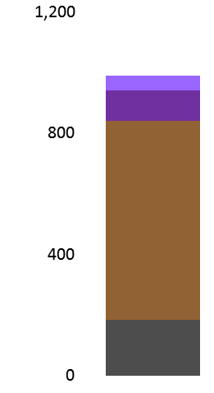
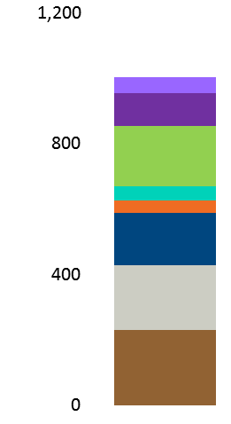
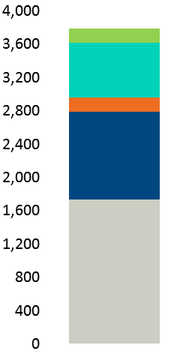
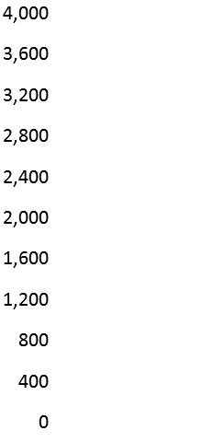
How a Regional Market Can Drive Clean Energy Adoption (cont’d)
Traditional Capacity Market
Integrated Clean Capacity Market
Cleared CEACs
GWh
Cleared Capacity
UCAP MW
Cleared CEACs
GWh
Cleared Capacity
UCAP MW
Energy Efficiency
Energy Efficiency
Demand Response
Demand Response
Gas
Coal
No CEACs Procured
Battery
Wind
Solar
Hydro
Nuclear
Gas

Slide 10
Regional Discussions
OPSI: Competitive Policy Achievement Working Group
PJM: Clean Attribute Procurement Senior Task Force
Chartered in September 2021 “to develop a new, voluntary, market procurement process that facilitates state policy goals”
Two consultants: RMI & Brattle
Meet weekly and have been in discussion with PJM throughout its efforts
Reached consensus on core market principles
Reached consensus on certain components of any future market
Potential standstill on remaining market design
Chartered on April 27, 2022 to consider various clean attribute procurement proposals
Only 4 meetings thus far
Should have modeling of the options by beginning of 2023
Should have a PJM solution developed by June 2023
“no solution” is a solution
Any solution is then subject to PJM voting and FERC approval

Slide 11
Main Recommendations from 2022 Progress Report
An Integrated Clean Capacity Market Would Result in Significant Cost Savings and Accelerate the Clean Energy Transition & New Jersey Should Continue to Advocate for its Adoption at the Regional Level;
New Jersey Should Favor Procurement of Clean Capacity Over Capacity From Emitting Resources to Meet its Reliability Needs; and
While Regional Efforts Continue Under Uncertainty, New Jersey Should Establish a Regional Voluntary Clean Energy Market.

Slide 12
Reliability Remains Paramount Concern
Any regional clean energy (or capacity) market structure must continue to enforce existing PJM reliability metrics, as established by PJM and FERC.
This includes appropriate reserve margins, enforcement of localized transmission and generation constraints, and other operational parameters that have historically led PJM to have a high degree of bulk system reliability.
Staff notes that each of Staff’s recommendations included in this report will allow PJM to secure the same high level of bulk system reliability that New Jersey consumers receive today.

Slide 13
Clean Energy Market Benefits
The evidence developed by Staff suggests that a regional market for clean energy attributes would:
Reduce GHG emissions across the PJM footprint, beyond what could be achieved by New Jersey alone;
Create a transparent, forward price for clean energy attributes that does not currently exist in today’s energy markets;
Create financeable offtake arrangements that drive low-cost renewables adoption; and
Create substantial net benefits for New Jersey consumers.

Slide 14
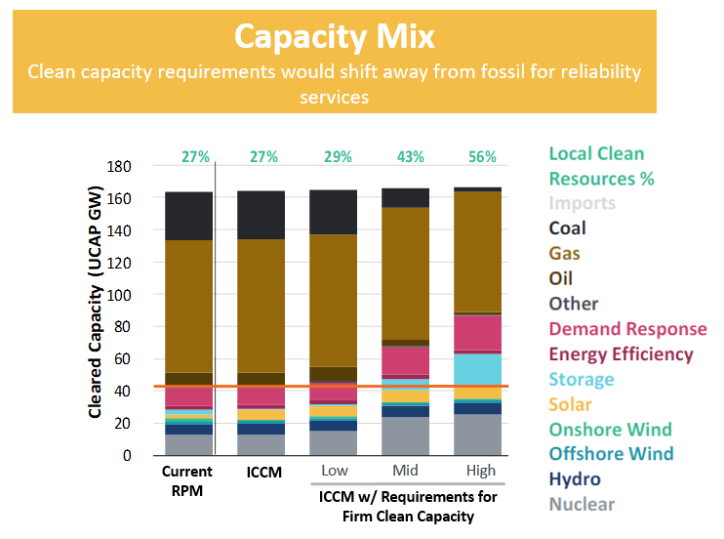
Clean Capacity Credit Product
A Clean Capacity Credit product will ensure reliability through the clean energy transition:
Provides an additional revenue stream to resources with locational reliability value that are of specific interest to NJ.
Open to other interested states and any voluntary clean energy buyers.
Together with the FCEM, closely approximates the economic efficiencies implementing a PJM ICCM would provide.
Implementable either through the PJM market or by NJ and/or interested states.

Slide 15
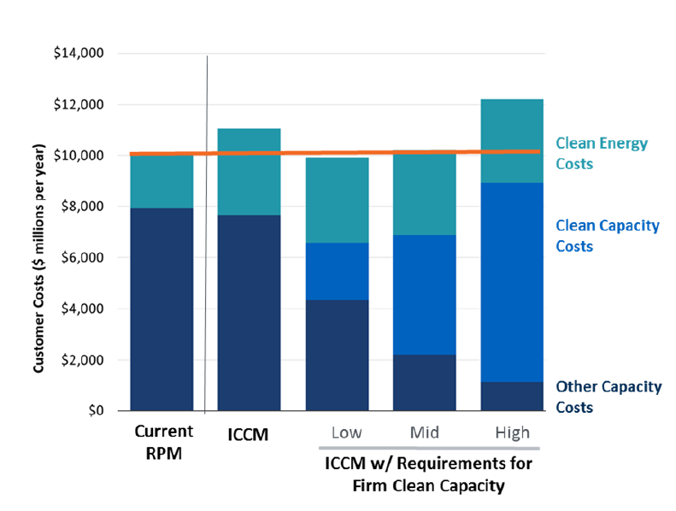
New Jersey Should Establish Voluntary Regional Clean Energy Market
In parallel with regional efforts, Staff recommends that New Jersey create a forward clean energy market.
Awards backed by long-term price lock to minimize finance risk & lower costs.
Provides forward price signaling to foster investment in clean energy resources
Receives nearly all, but not 100%, of the economic benefits realized under an ICCM.
Approx. 95% when paired with capacity constraint.

Slide 16
State-Led FCEM Implementation vs. PJM Integration
State-Led FCEM
PJM FCEM
Sponsored by NJ and implemented outside of PJM’s tariff.
Open to other interested states and any voluntary clean energy buyers.
Three-year forward auction, comparable to RPM.
Establish a Clean Energy Market Purchase Obligation for NJ Load Serving Entities
Similar to RPS implementation
Aggregate regional demand of clean energy attributes
Clean Energy Attributes in MWh (REC) and MW (CCC)
Slightly less economic efficiencies (<5%) when the capacity product and clean energy attribute product are separated into different markets.
Economic benefit will depend on participation from those outside of NJ (not guaranteed)
Governance/Jurisdiction:
State agreement for a RGGI-like regime
Within the existing PJM system under a state governance framework

Slide 17
Governance Considerations
Staff recommends that the Board examine a governance model that:
Provides state regulators a clear role in overseeing any market comparable to the rights exercised by the existing PJM Board of Directors, including appropriate filing rights at the Federal Energy Regulatory Commission;
Provides participants in the clean energy market, including buyers, sellers, consumer advocates and state regulators with a dominant share of stakeholder votes;
Ensures that states retain primary jurisdiction over their clean energy policies;
Relies, as much as possible, on the existing PJM system for tracking environmental attributes, known as the PJM-EIS Generator Attribute Tracking System (“GATS”); and
Includes a fully qualified and equipped market administrator, potentially a neutral, third party, to conduct the design work and run the auction.

Slide 18
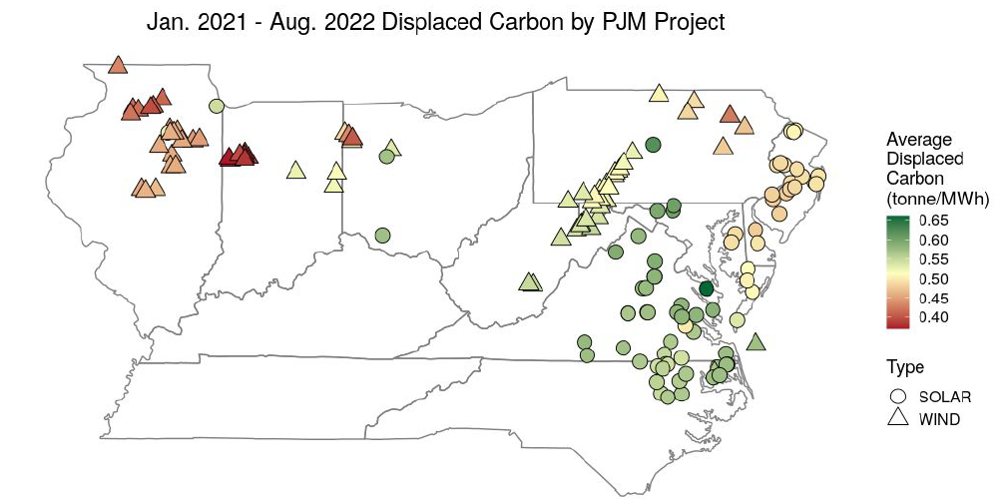
Secondary Recommendation: Consider Carbon Indexing of Clean Energy Credits
Consider indexing clean energy compensation to the carbon intensity of the grid at the time the clean energy is produced.
Indexing would allow NJ to provide higher compensation for clean energy produced when emissions are high, while providing lower levels of compensation to clean energy produced during times when the grid is relatively clean.
See Energy Storage Straw Proposal and Energy Master Plan’s discussion of “time-bound environmental credits or other mechanisms for emissions abatement verification…” (p. 104)
Illustrative carbon values; Resurety, GhG Abatement Product, PJM CAPSTF

Slide 19
Stakeholder Comments

Slide 20
Webinar Instruction Page
All attendees will be automatically muted until called upon to speak.
When we get to the public comment portion, we will start with speakers who pre-registered. You will be called up and then unmuted.
Speakers who did not pre-register may raise their hand to speak and will be called on.
We are going to ask speakers to keep their comments to less than 8 minutes.
Questions? Please use the “Q & A” function in Zoom.
Please note that the “Chat” function in Zoom is not available for this meeting.
This meeting is being recorded.
A copy of the recording and slides will be made available on the BPU website: https://www.nj.gov/bpu/newsroom/public/

Slide 21
Written Stakeholder Comment Guidelines
The deadline for comments on the 2022 Progress Report is 5:00 p.m. ET on October 25, 2022.
Please submit comments directly to Docket No. EO20030203, using the “Post Comments” button on the Board’s Public Document Search tool.
Comments are considered “public documents” for purposes of the State’s Open Public Records Act and any confidential information should be submitted in accordance with the procedures set forth in N.J.A.C. 14:1-12.3.
Written comments may also be submitted to:
Acting Secretary of the Board
44 South Clinton Avenue, 1st Floor
Post Office Box 350
Trenton, NJ 08625-0350
Phone: 609-292-1599
Email: board.secretary@bpu.nj.gov

